Slide 1

[Evaluation findings of the tablet launch]
We surveyed 50 of Sauce & Spoon friends and family members through the tablets at the end at the end of their dinning experience on the test launch event to learn about their satisfaction with the ordering process, waiting time, technical issues, and customer support.

Slide 2
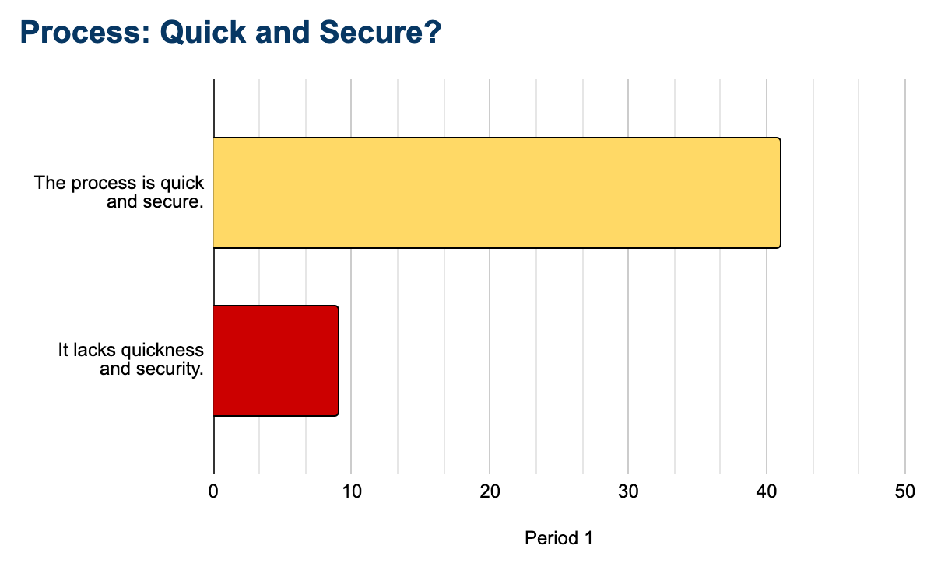
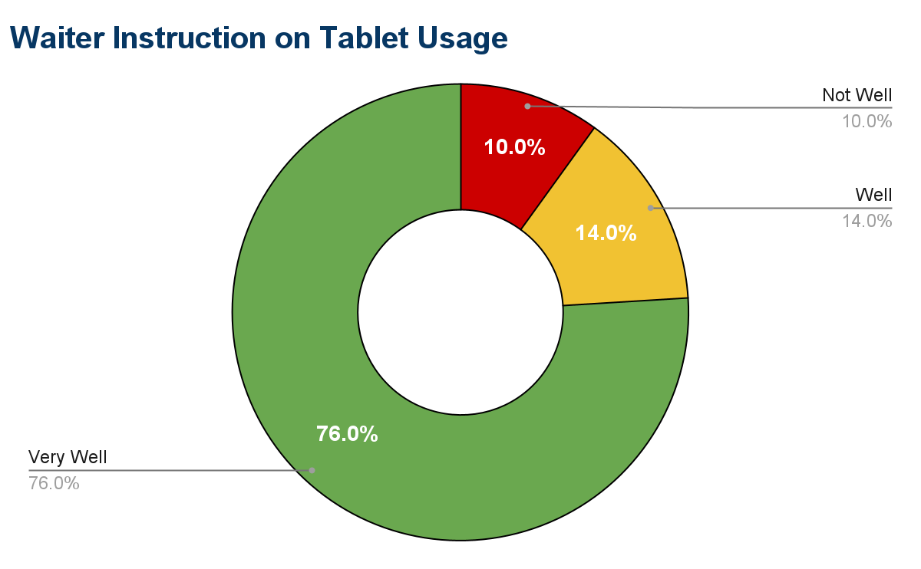
Summary
As per the survey, the data gathered from the tablet rollout has resulted to a positive outcome. It is determined that majority of the 50 respondents liked the usage of tablet in placing an order. However, there are also areas that can be improved to better satisfy the customers. Below are charts that determined the positive outcome of the project:

Slide 3
Overview
What did we want to measure in the test launch surveys?
Average ticket time: Aiming for an average ticket time between 8 and 15 minutes.
Check out time: Aiming for a check out time of 1 minute or less.
Technical issues: Aiming for less than 5% technical issues for the customers.
Order accuaracy: Aiming for 98% order accuracy.
Customers wait time in the lobby: Aiming for 10 minutes or less.

Slide 4
Findings
We asked the question: “On average, how long did it take to receive your food order?”
What we wanted to measure was the average ticket time.
Our aim was to have an average ticket time between 8 minutes and 15minutes, 44% of our customers didn’t comply with that.

Slide 5
Next Steps
Gather with the staff
It would be great to gather with the staff to research further what the reason might be for this delay.
Also with the data that we have at hand, we don’t know if this is actually an improvement compared to our service before implementing the tablets. My advice is to compare this data with previous data to be able to reach a more accurate conclusion.

Slide 6
Next Steps
Hire staff
Since 44% of the customers that we surveyed didn’t comply with our quality standards, we suspect that the problem might be that we need more staff because the tablets might have increased the speed of service regarding the order process, and therefore the staff that we have can’t keep up with the demand that results in a delay of the service.

